Slide 1
Technical Info + Customized Card Comparison
Based on DBS cards

Slide 2
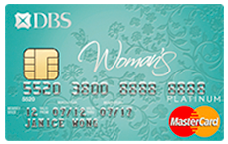
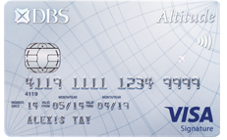
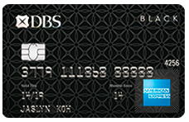
Filter Result
← Back
1
2
Apply
Compare Cards
DBS Woman's MasterCard® Card
DBS Altitude Visa Signature Card
3
DBS Black American Express® Card
All cards

Slide 3







DBS Woman's MasterCard® Card
← Back
Help me compare?
Annual Fee:
S$200
Card Reward:
5% cash back
Shopping:
5% cash back
Transport:
XX privilege
Condition of usage:
At least buy S$ 100 per year
Limited to capital mall
Movie:
XX privilege

Slide 4
DBS Woman's MasterCard® Card
← Back
Help me compare?
Annual Fee:
S$200
The annual fee is the money charged per year for managing your account.
It can be waived. How?
Card Reward:
5% cash back
Shopping:
5% cash back
Transport:
XX privilege
Condition of usage:
At least buy S$ 100 per year
Limited to capital mall
Movie:
XX privilege

Slide 5
How to waive annual fee
← Back
Step 1: XXXX
Step 2: XXX
Step 3: XXX

Slide 6
DBS Woman's MasterCard® Card
← Back
Help me compare?
Annual Fee:
S$200
Card Reward:
5% cash back
Shopping:
5% cash back
Transport:
XX privilege
Condition of usage:
At least buy S$ 100 per year
Limited to capital mall
Applicable to:
XXX users
Other info about transport privilege.
Movie:
XX privilege

Slide 7

DIY CARD COMPARER
← Back
Recommended for You
Card Type
DBS Points
Dining
Health
care
Movies
Travel
Min Income
Miles
American Express | 1X DBS Point on all transactions | 1 | Same | No | X | X | X
Visa | No expiry date for DBS Rewards Points2 | 2 |  | 5% cash back | X | X | X
MasterCard | Earn 5X DBS Rewards Points on all online purchases | 2 |  | X | X | X | X
DBS Black American Express® Card
DBS Altitude Visa Signature Card
DBS Woman's MasterCard® Card
Notes:
We could rank the credit cards by each category for users to choose most suitable one.. Then when they click DONE it iwll g back to original information for each category
Comparison scheme is based on DBS’ comparison tool
Users can click + to expand information for each technical term

Slide 8
DIY CARD COMPARER
← Back
Recommended for You
Card Type
DBS Points
Health
care
Movies
Travel
Min Income
Miles
American Express | 1X DBS Point on all transactions | Same | No | X | X | X
Visa | No expiry date for DBS Rewards Points2 |  | 5% cash back | X | X | X
MasterCard | Earn 5X DBS Rewards Points on all online purchases |  | X | X | X | X
DBS Black American Express® Card
DBS Altitude Visa Signature Card
DBS Woman's MasterCard® Card
Notes:
We could rank the credit cards by each category for users to choose most suitable one.. Then when they click DONE it iwll g back to original information for each category
Comparison scheme is based on DBS’ comparison tool
Users can click + to expand information for each technical term

